Slide 1

INSTAGRAM USER ANALYTICS
Ahamed Salman khan B
DMT6

Slide 2



INSTAGRAM
• Over 2 billion active users spend significant time engaged on Instagram, making it a prime spot to connect with your target audience.
• Powerful visuals and storytelling capabilities allow you to showcase your brand and grab attention in a memorable way.
• Targeted advertising reaches the right people, while shoppable features turn browsing into sales with ease. Influencer partnerships amplify your brand message through trusted voices.
• Stories and Reels offer a dynamic way to share fleeting content and foster real-time engagement.
• Insights and analytics provide valuable data to track performance, understand your audience, and refine your strategy.

Slide 3

MARKETING ANALYSIS

Slide 4
Loyal User Reward: The marketing team wants to reward the most loyal users, i.e., those who have been using the platform for the longest time.
Your Task: Identify the five oldest users on Instagram from the provided database

Slide 5
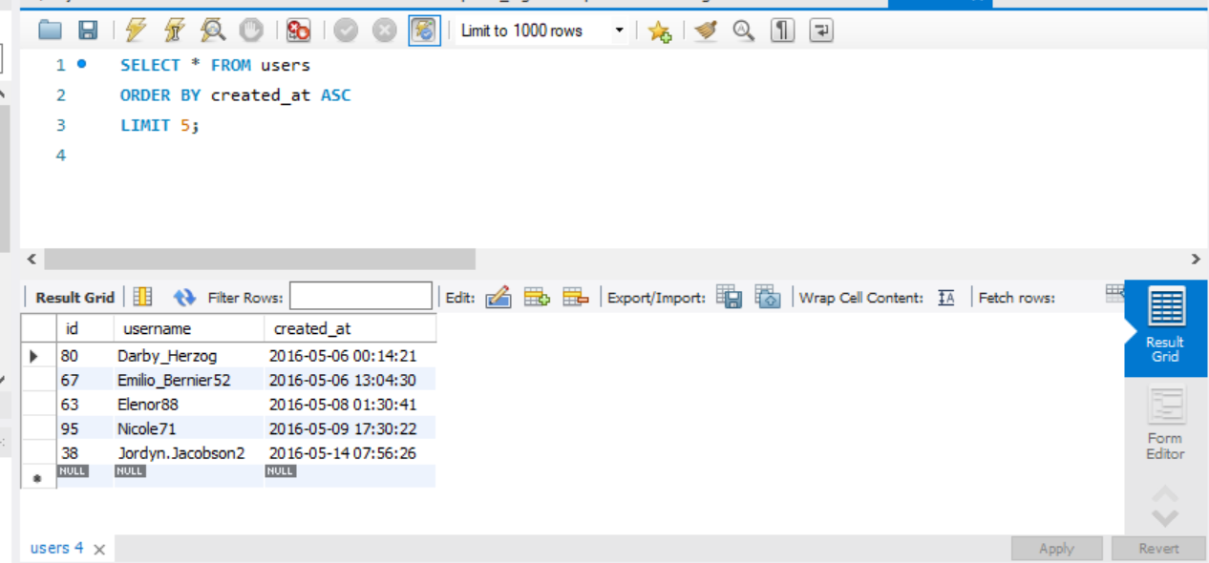
Loyal User Reward

Slide 6
Inactive User Engagement: The team wants to encourage inactive users to start posting by sending them promotional emails.
Your Task: Identify users who have never posted a single photo on Instagram

Slide 7
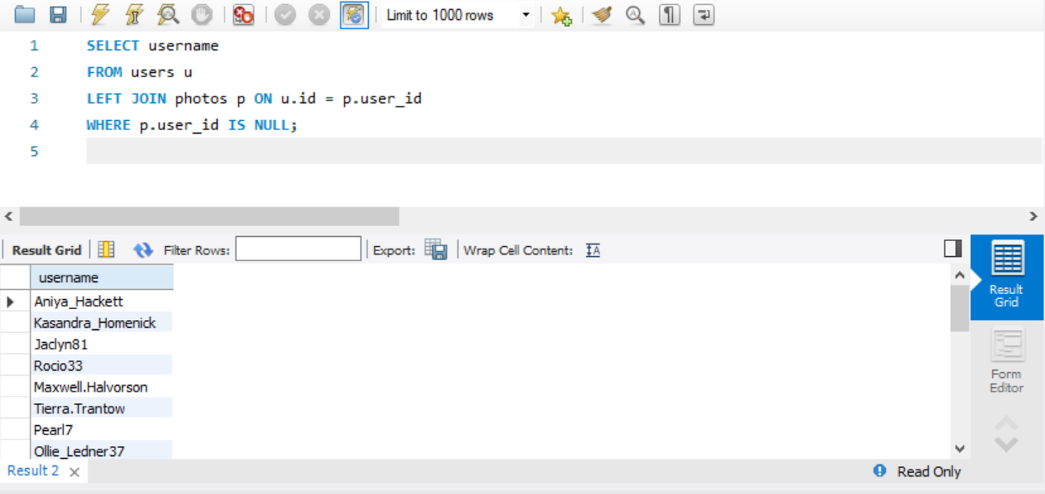
Inactive User Engagement

Slide 8
Contest Winner Declaration: The team has organized a contest where the user with the most likes on a single photo wins.
Your Task: Determine the winner of the contest and provide their details to the team.

Slide 9
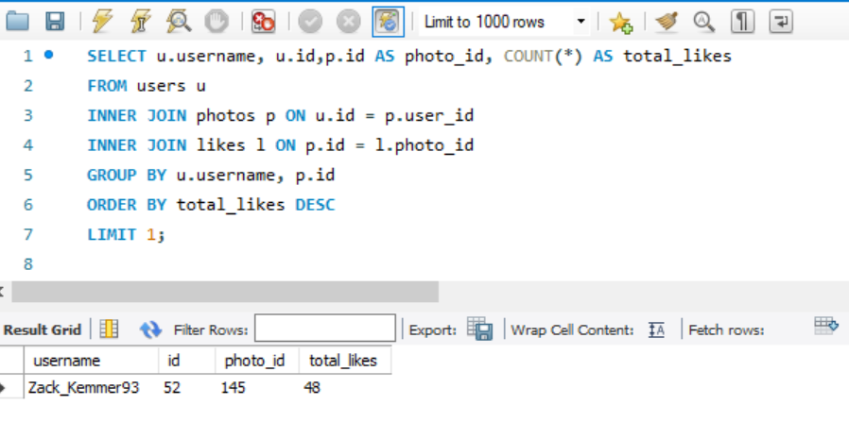
Contest Winner Declaration:

Slide 10
Hashtag Research: A partner brand wants to know the most popular hashtags to use in their posts to reach the most people.
Your Task: Identify and suggest the top five most commonly used hashtags on the platform.

Slide 11
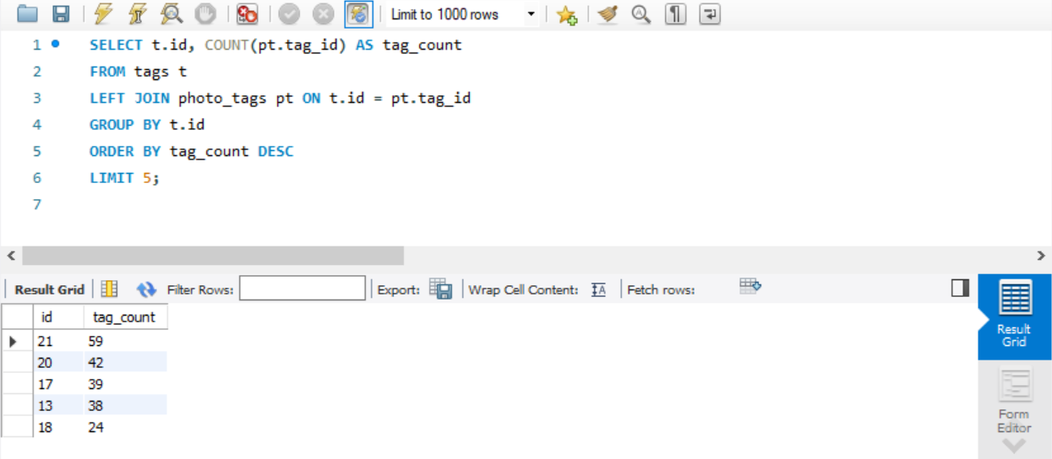
Hashtag Research

Slide 12
Ad Campaign Launch: The team wants to know the best day of the week to launch ads.
Your Task: Determine the day of the week when most users register on Instagram. Provide insights on when to schedule an ad campaign

Slide 13
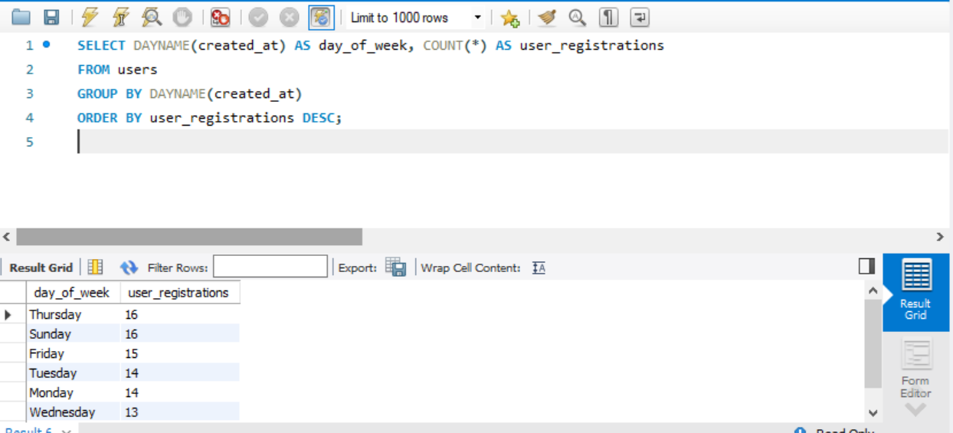
Ad Campaign Launch

Slide 14


INVESTOR METRICS

Slide 15
User Engagement: Investors want to know if users are still active and posting on Instagram or if they are making fewer posts.
Your Task: Calculate the average number of posts per user on Instagram. Also, provide the total number of photos on Instagram divided by the total number of users

Slide 16
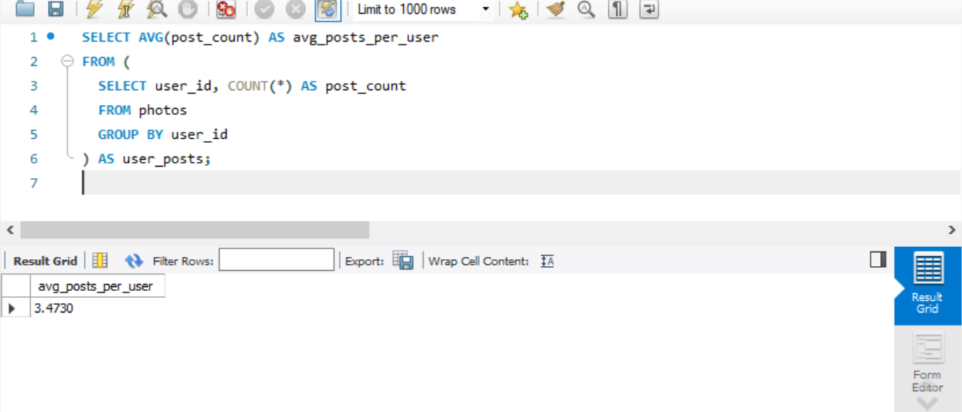
User Engagement

Slide 17
Bots & Fake Accounts: Investors want to know if the platform is crowded with fake and dummy accounts.
Your Task: Identify users (potential bots) who have liked every single photo on the site, as this is not typically possible for a normal user

Slide 18
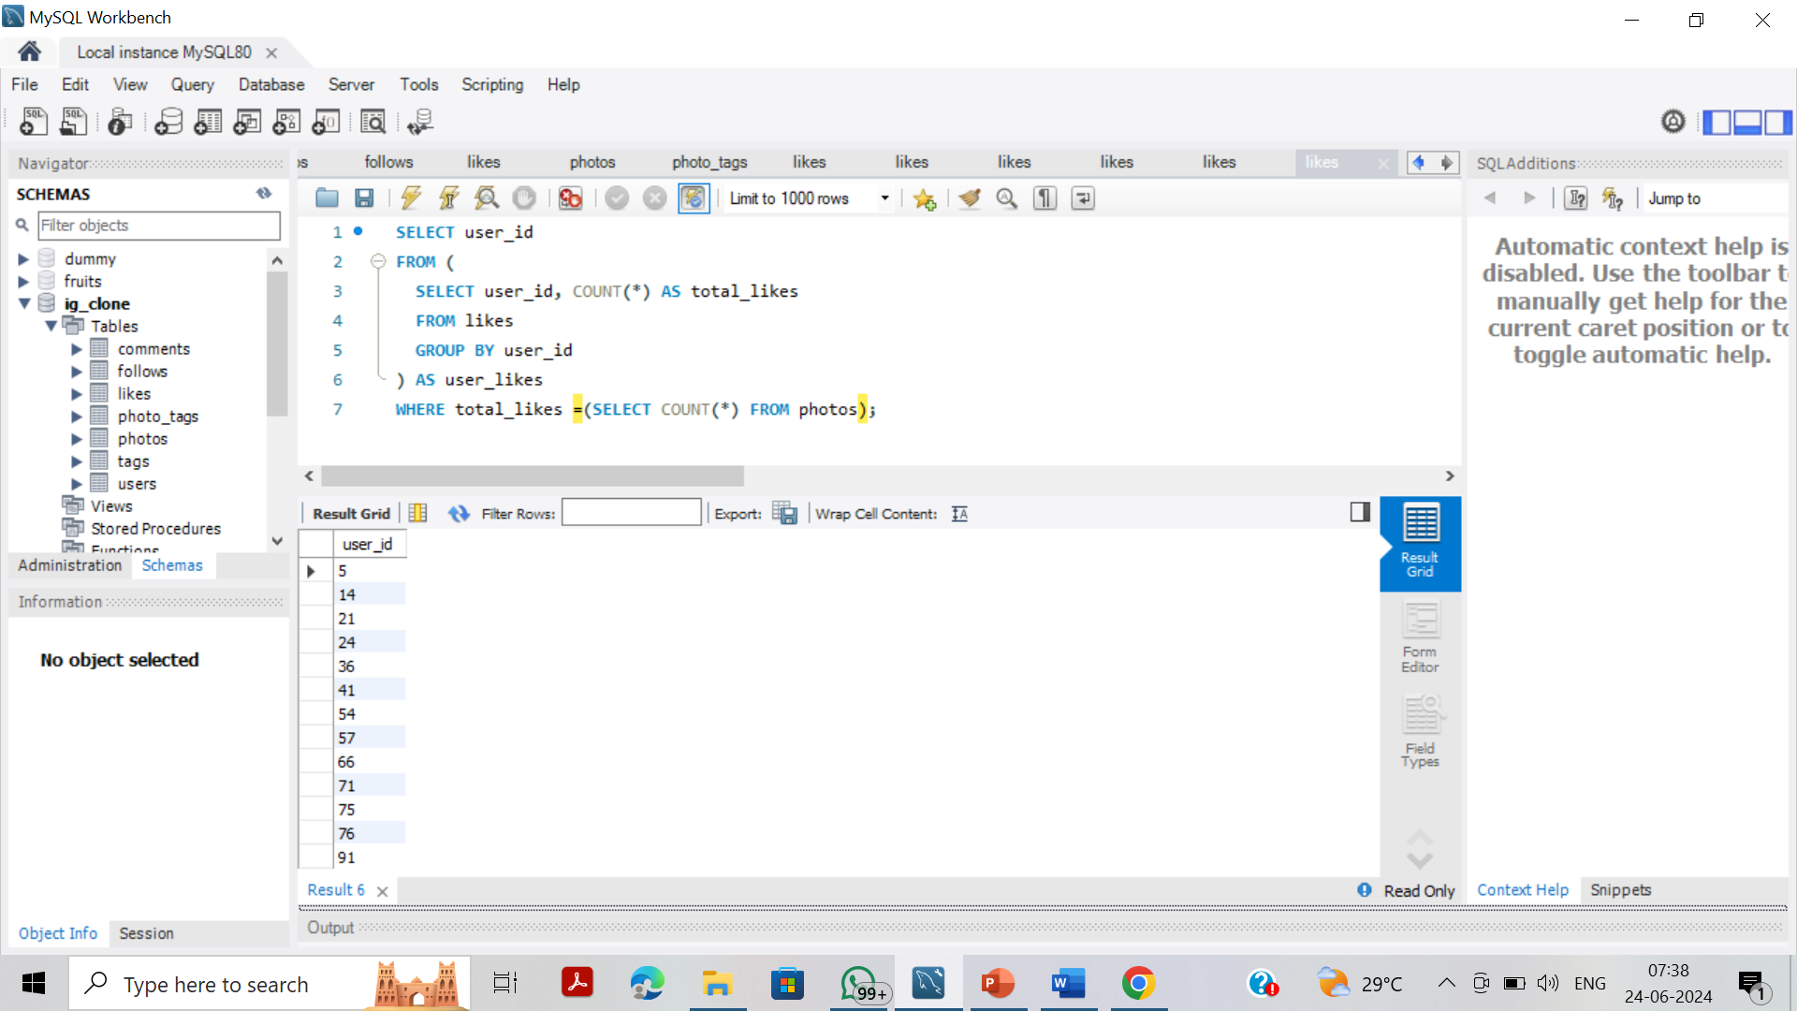
Bots & Fake Accounts

Slide 19
CONCLUSION
Identifying Loyal Users: Explore internal user analytics tools or consider alternative methods like surveys or contests to target long-time, engaged users.
Filtering Out Bots & Fake Accounts: Implement safeguards to identify and filter out bot and fake accounts to ensure program effectiveness and target genuine users.
Ad Campaigns: Analyse internal user login activity across different days of the week to identify peak user activity periods. Schedule ad campaigns to launch on these high-engagement days to maximize reach and impact among your target audience.

